Slide 1
Prevention of Batch Mix-Up Using Automatic Cartridge QR Scanning Jig
Name: Penke Lakshmana Sai Kaushik
Department: Quality Assurance - site III
Project Name: Real-Time Batch / Line Mix-Up Detection

Slide 2
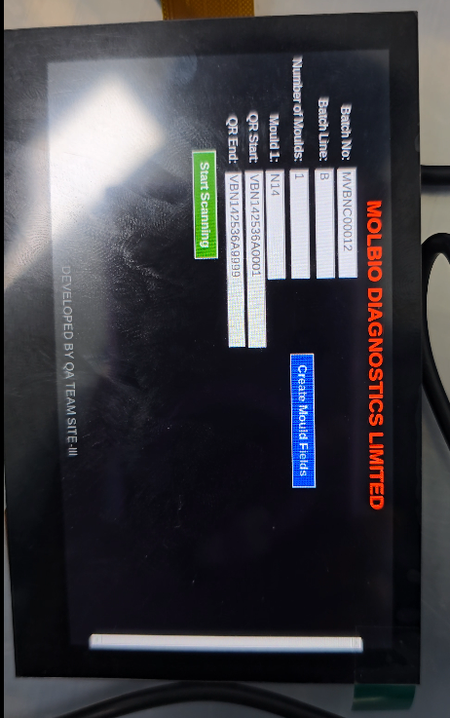
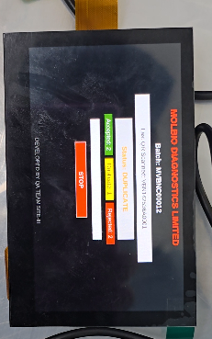
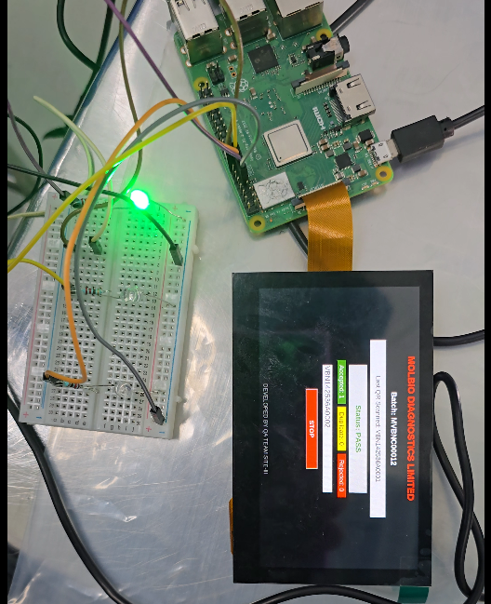
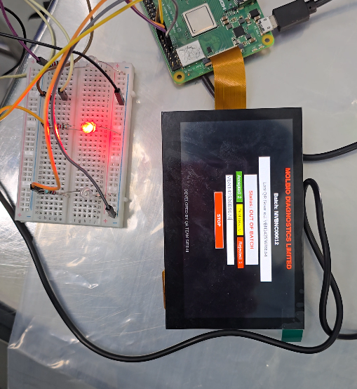
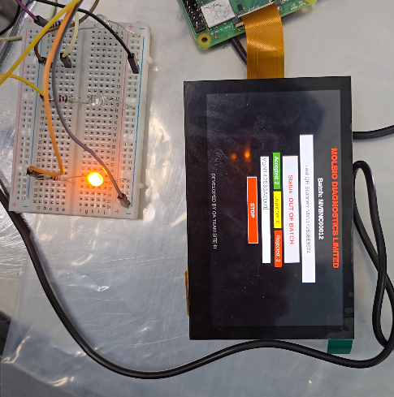
Prevention of Batch Mix-Up Using Automatic Cartridge QR Scanning Jig
Prototype model:
Built a prototype model and successfully tested below are the reference images.

Slide 3
Prevention of Batch Mix-Up Using Automatic Cartridge QR Scanning Jig
Objective of the Initiative:
Prevent batch mix-ups in production.
Identify incorrect cartridges before they move forward.
Implement real-time validation using existing automatic Cartridge QR scanning JIG.
Real-time scanned cartridges data will stored as CSV file.

Slide 4
Prevention of Batch Mix-Up Using Automatic Cartridge QR Scanning Jig
Flow Chart:
Automatic Cartridge QR Scanning JIG
↓
Load Cartridges in Stacker
↓
QR Code Scanned by Jig
↓
It will check for : QR Code / Batch Range / Line / Count
↙ ↘
Pass → Move Forward Fail → Alert / Divert Cartridge
↓
Next Cartridge Drops
↓
Repeat the Process
If it is same batch cartridge
If it is different Batch/Line cartridge

Slide 5
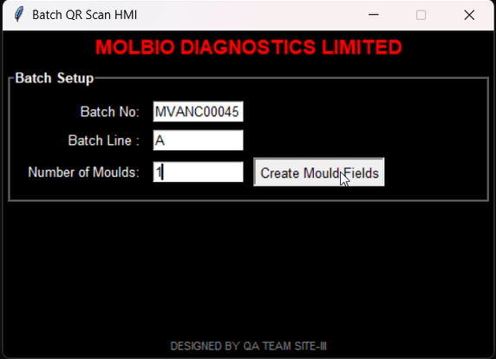
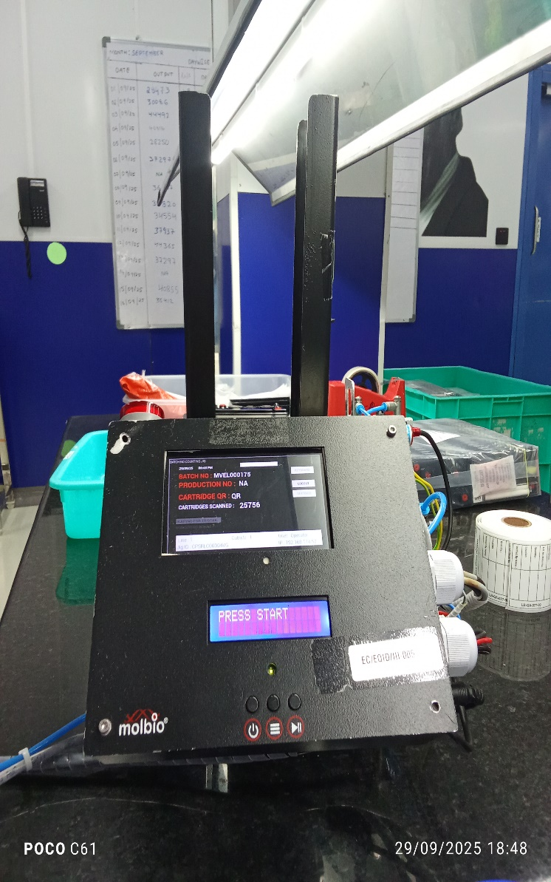
Prevention of Batch Mix-Up Using Automatic Cartridge QR Scanning Jig
Enter the Batch Details on JIG
Automatic Cartridge QR Scanning JIG
Stage-2
Stage-3
Enter the details Batch no. ,Line, No. of Moulds
Stage-1
After Giving Batch Details click on Create Mould Fields
If this batch having >1 mould, then enter that No.

Slide 6
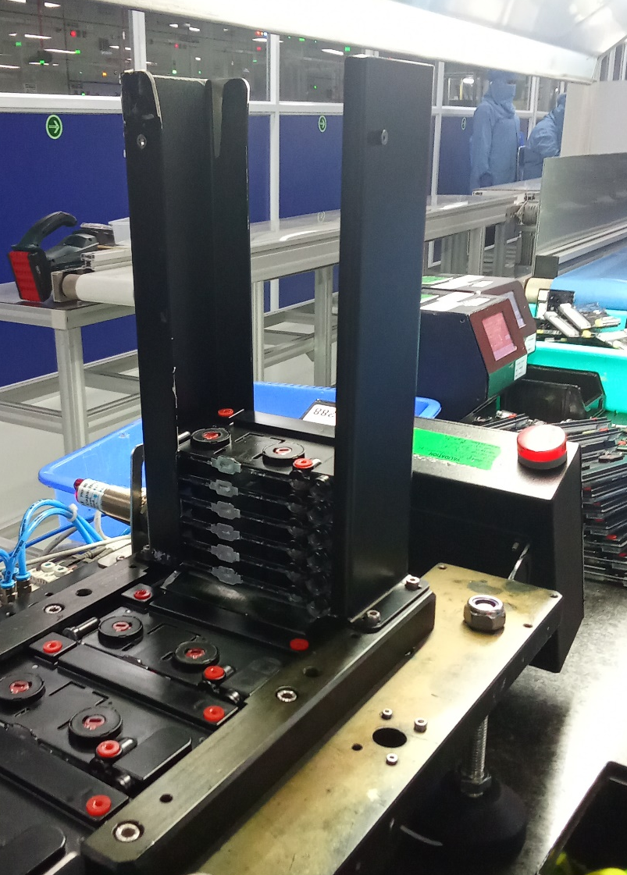
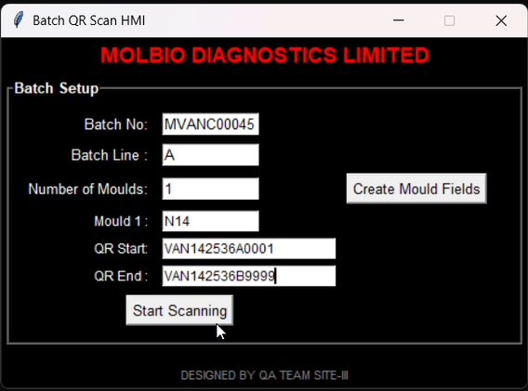
Prevention of Batch Mix-Up Using Automatic Cartridge QR Scanning Jig
After Clicking on Create Mould Fields it will ask for Mould type and QR Start number End number
Load Cartridges in Stacker
Stage-3
Stage-4
Stage-5
Enter the Mould type and QR start and QR end number
After Filling Required Details Click on Start Scanning

Slide 7
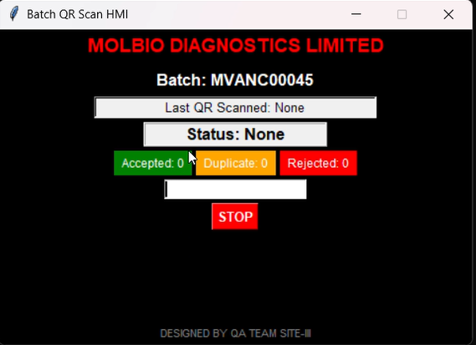
Prevention of Batch Mix-Up Using Automatic Cartridge QR Scanning Jig
What it will check when cartridge is scanned:
After Loading Cartridges it will scan QR codes.
Batch Input:
Batch = MVANC00045
Line = A
Range = VAN142536A0001 → VAN142536B9999
Scans:
VAN142536A0001 → ✅ Pass (within range).
VAN142536A5000 → ✅ Pass
VAN142536B0002 → ✅ Pass
VAN142536C0003 → ❌ Reject (outside range)
VBN142536B0100 → ❌ Reject (wrong line).
VAN142536A0001 → ✅ Duplicate scan
Stage-5
Stage-6

Slide 8
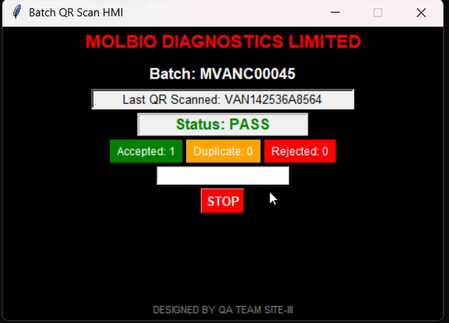
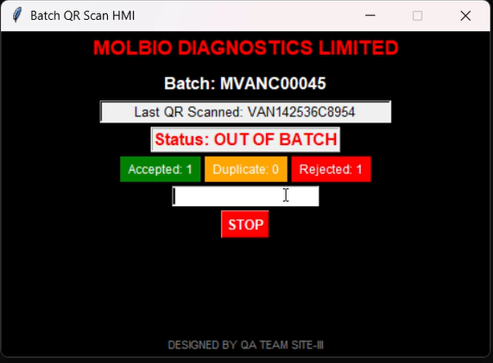
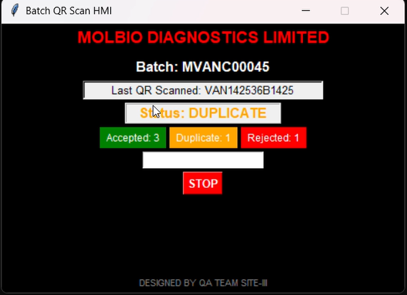
Prevention of Batch Mix-Up Using Automatic Cartridge QR Scanning Jig
Stage-6
I/P: Same Batch Cartridge
I/P: Different Batch Cartridge
I/P: Same Cartridge Re-scanned
Blink Red Light with Buzzer Sound
Blink Yellow Light
Blink Green Light
Pass
Rejected
Duplicate
If cartridge is from same batch it will pass and scan next cartridge
If cartridge is from different batch it will reject and scan next cartridge
If cartridge is Re-Scanned it will pass and show as duplicate and scan next cartridge

Slide 9
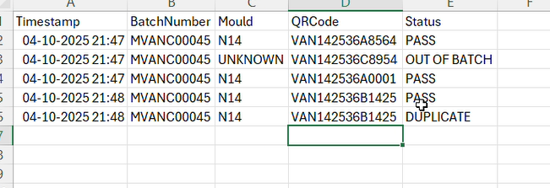
Prevention of Batch Mix-Up Using Automatic Cartridge QR Scanning Jig
Stage-7
Automatically stores scanned QR data in CSV file.
All scanned data shall be linked to Dashboard by Batch Number and there should be a provision to export CSV files (scanned batch data) from the dashboard. This will help us maintain the data for a longer period and easy to access.

Slide 10
Prevention of Batch Mix-Up Using Automatic Cartridge QR Scanning Jig
Scanning and Validation check
Line Validation
QR Line must match the batch line.
❌ If mismatch → Reject, Red Light blink
Range Validation
QR Serial must be within the QR Range Start → QR Range End
❌ If outside → Reject, Red Light blink
Duplicate / Re-Scan Check
If QR already scanned → ✅ Pass, Yellow Light blink
Else → ✅ Pass, Green Light blink

Slide 11





For more information:
www.molbiodiagnostics.com
Write us at:
@molbiodiagnostics.com
Call us at:
+91
Thank You
DISCLAIMER
This presentation has been prepared exclusively for information purposes only and is strictly confidential. The information and statistical data herein have been extracted from internal documents, publicly available information and/ or also obtained from sources the parties involved in the preparation of this presentation believe to be reliable but in no way are warranted by them as to accuracy or completeness. The parties involved in the preparation of this presentation accept no responsibility for any losses resulting from the use or transmission of the data or views represented in this presentation. The recipient is provided the information contained herein on a confidential basis which should not be disclosed to third parties or duplicated or used for any purpose.
The parties involved in the preparation of this presentation shall not be liable for the relevance, accuracy or completeness of the information contained herein, and disclaim any and all liability as to the information set forth herein or omissions here from, including, without limitation, any express or implied representation or warranty with respect to such information.

